Slide 1
Calendar Year End 1099 Processing
11/6/2018

Slide 2
Transmitter Control Code
Apply for a Transmitter Control Code from IRS
This code is needed to upload 1099s to IRS
Form 4419 on fire.irs.gov website

Slide 3
Verify 1099 Data
Verify 1099 Box Codes
Run Cognos report – Vendors 1099 Info – as Excel Data
Look for vendors that should have an M in 1099 Misc Flag
Check the box codes:
Make any necessary changes in the Vendor List

Slide 4
Vendor Data
Update any vendors who were paid outside of eFP with applicable 1099 payments
Payment amounts should be entered in PREV column of 1099 Information tab
Add any missing Federal Tax IDs

Slide 5
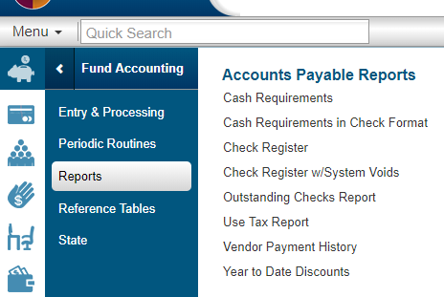
Verify payments are coded correctly
Run Vendor Payment History Report
Fund Accounting>Reports>Accounts Payable

Slide 6
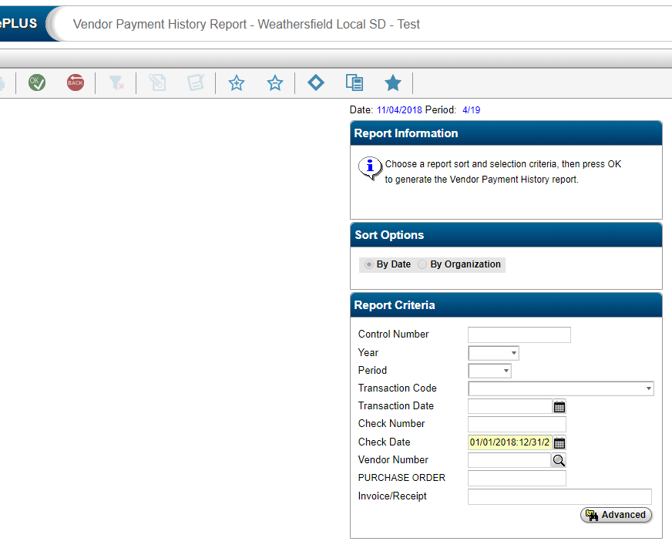
Vendor Payment History
Check Date : 01/01/2018:12/31/2018

Slide 7
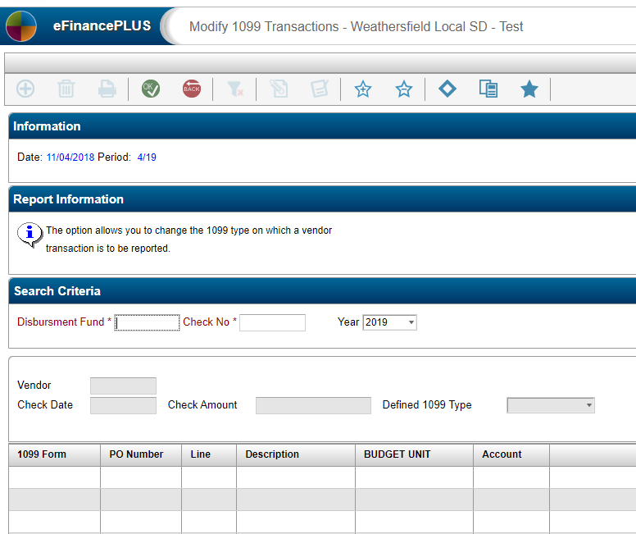
Vendor Payment History
Check report for amounts over IRS amounts.
Modify 1099 Types on Checks as needed
Fund Accounting> Periodic Routines> Modify 1099 Transactions
Notes:
Use check number 25848, fund 0010000 & 24619

Slide 8
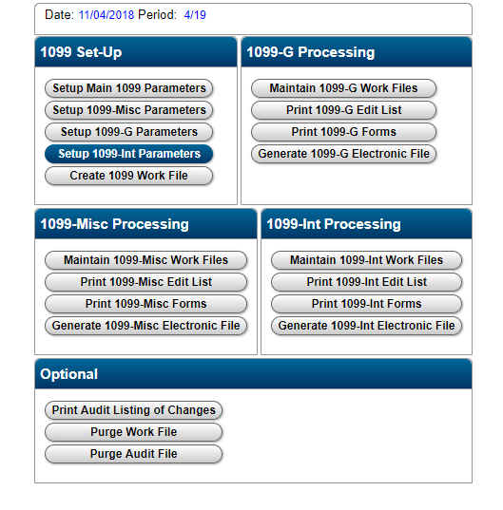
1099 Processing
1099 Processing Menu
Fund Accounting > Periodic Routines > Periodic Processing>1099 Processing

Slide 9
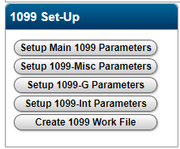
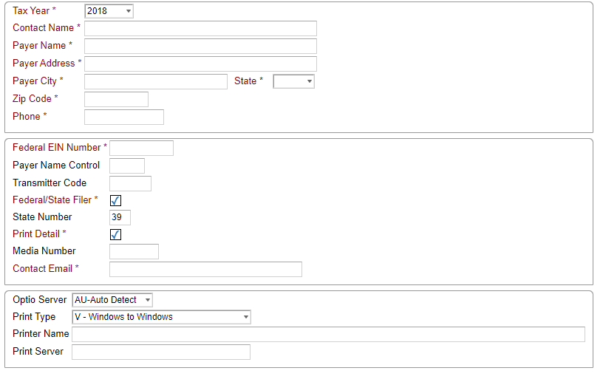
1099 Set-up
State Number is 39 for Ohio
Transmitter Code
Notes:
Transmitter Code is Transmitter Control Code that you applied for
Payer Name Control – we didn’t use
Optio Server – AU Auto Detect
Printer Type V – Windows to Windows
Printer Name is from Forms Manager, Print server – check with ITC 10.100.200.14 –is this NEOMIN’s?

Slide 10
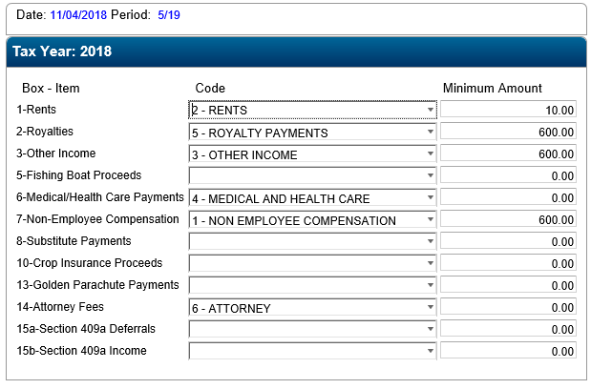
Setup 1099 Misc Parameters
Notes:
Match codes to boxes and put in Minimum amounts

Slide 11
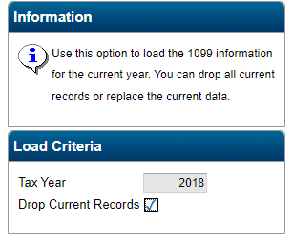
Create 1099 Work File
This can be done more than once!
Click on OK

Slide 12
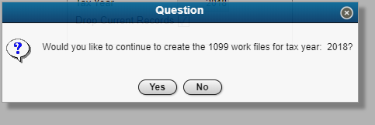
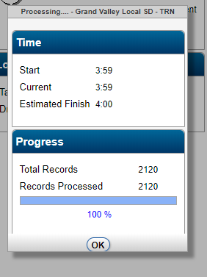
Create 1099 Work File
Click Yes
Click on OK
Notes:
Box will pop up saying The 1099 work file has been created

Slide 13
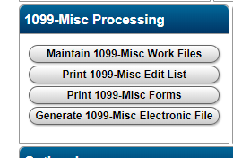
Print 1099 Misc Edit List

Slide 14
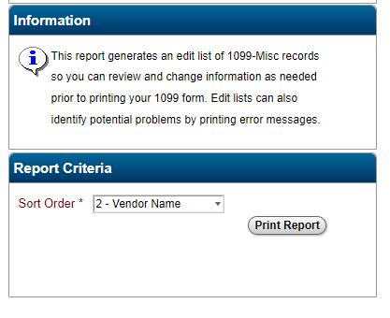
Print 1099 Misc Edit List
Notes:
Can be sorted by vendor number or name

Slide 15
1099 Misc Edit List

Slide 16
If Data needs updated
Why is it incorrect?
Fix in Fund Accounting or update in Maintain 1099 Work Files
If errors are fixed in Fund Accounting, Purge Work File for 2018 and go back to Create 1099 Work File
Select Maintain 1099 Work file
Enter search criteria and click on Find
Notes:
If data is incorrect in Fund Accounting and you have not cleared 1099 data yet, you can go back to fund accounting and make your changes. Then you will need to

Slide 17
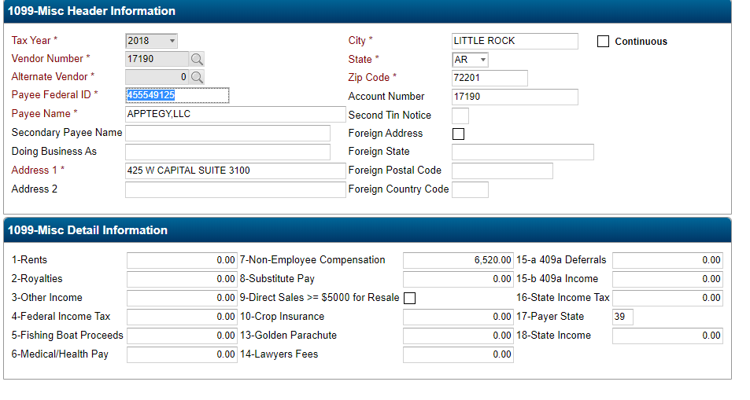
Maintain 1099 Data

Slide 18
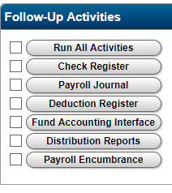
Maintain 1099 Data
Make any changes needed
Rerun Edit listing
Fund Accounting Interface in payroll can not be run for the first pay of 2019 until 1099 work file is correct.

Slide 19
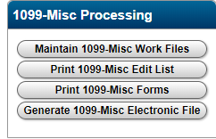
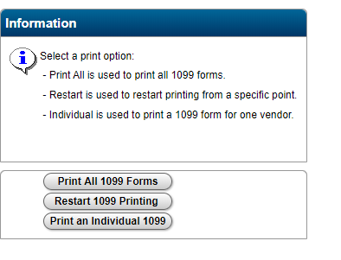
Printing 1099 forms
Print a test 1099

Slide 20
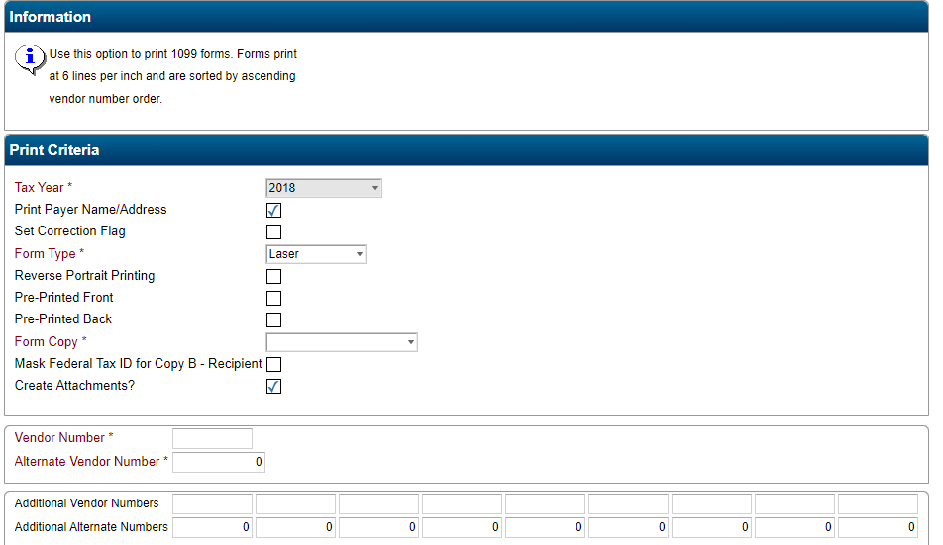
Printing 1099 forms
Notes:
Check your forms – for Vendors, Recipient, form type will be Pressure Seal and check Pre Printed Back
For Payer Copy will be laser
Make sure that all data appears on the 1099
Print all 1099s

Slide 21
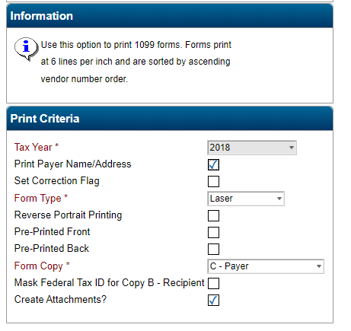
Print All 1099 Forms
Notes:
When printing recipient copies, mark Create Attachments. This will create a copy of the 1099 and attach it to the vendor record

Slide 22
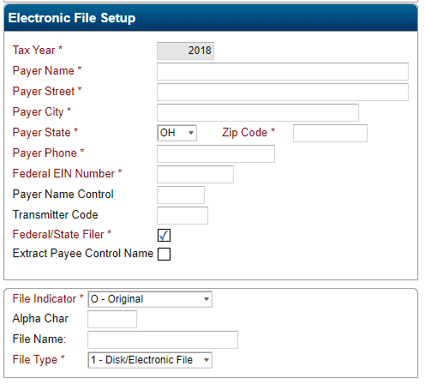
Generate 1099-Misc Electronic File
Upload the electronic file to fire.irs.gov. This can be done later. Due date is January 31, 2019

Slide 23
Finishing up
Backup Fund Accounting to Disk
System Administration > Backup Fund Accounting to Disk
Contact your ITC to request a backup of your data
Clear 1099 data – Fund Accounting > Periodic Routines > Periodic Processing > Clear 1099 Amounts
January processing can be started

