Slide 1
USAS
2023 Calendar Year End
Closing Procedures

Slide 2
2023 Calendar Year End Agenda
Pre-Closing Procedures
Calendar Year End Close
1099-NEC & 1099-MISC Procedures

Slide 3
Due dates of Forms & Instructions
Filing of 1099 - NEC
Filed with the IRS on paper or electronically January 31, 2024.
A copy of Form 1099-NEC should also be sent to your vendors and independent contractors by January 31, 2024.
Filing of 1099-MISC
Filed with the IRS electronically by March 31, 2024.
A copy of Form 1099-MISC should be sent to the MISC recipients by Jan. 31, 2024.
General Instructions for Certain Information Returns
https://www.irs.gov/instructions/i1099gi

Slide 4
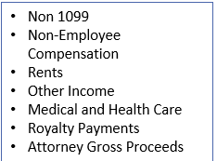
CYE – Things that can be done now
Review & Verify:
Vendors 1099 Location (address)
Vendors Tax ID Type (SSN or EIN)
Vendors ID #
Vendors Type 1099

Slide 5
IRS Taxpayer Identification Number (TIN) Matching Program with the IRS
What is this Optional TIN Matching Program ?
IRS TIN Matching Program can optionally be used to check whether a SSN or EIN should be used when reporting the vendor to the IRS.
This verification is done by matching the Name and Number combination on the IRS interactive site for immediate verification.
For more information: https://www.irs.gov/tax-professionals/taxpayer-identification-number-tin-matching

Slide 6
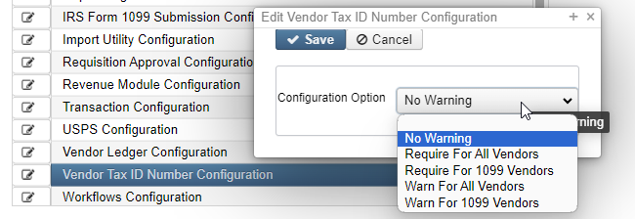
Vendor Tax ID Number Configuration
System < Configuration < Vendor Tax Id Number Configuration
District can configure this to allow validation when entering a new vendor.

Slide 7
CYE – Things that can be done now Review & Verify Vendor’s information
1099 Vendor Information located under Core / Vendors
Vendor’s Location section:
Vendor’s 1099 section:

Slide 8
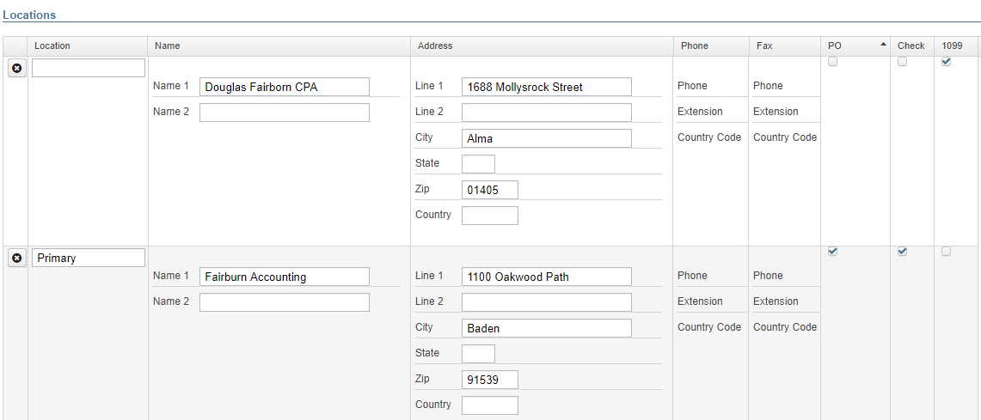
Verify / Edit Vendor details
Vendor Names/Addresses
Name/address on W-9 form may be different than name/address for checks
Notes:
If a vendor's 1099 location is specified on the vendor record, it will pull the information from that location onto the 1099. If 1099 location isn't specified on a vendor record, it will default to the PO location.

Slide 9
Several Options to Review 1099 Data
Vendor’s Grid
Core > Vendors
SSDT 1099 Vendor Report
Report Manager
1099 Extract Report
Periodic > 1099 Extracts > Print 1099 Report

Slide 10
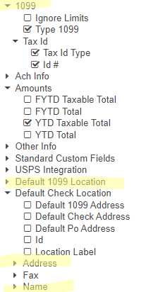
Vendors Grid – MORE button
1099 Info
Type 1099
Tax ID Type
Id#
Default 1099 Location
Name
Address
Use the Report button to save your filtered grid settings

Slide 11
Vendors Grid
View the Grid details
You can also generate a Report from Vendor’s Grid details

Slide 12
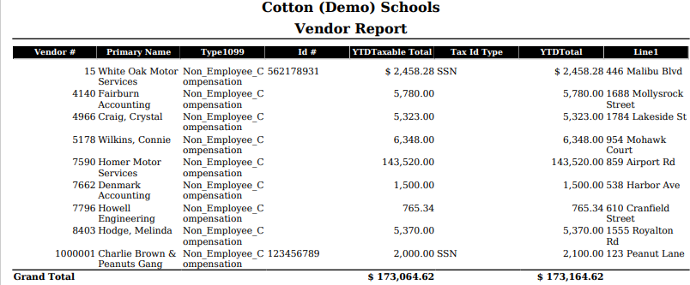
Generate a report from your Vendor Grid’s results

Slide 13
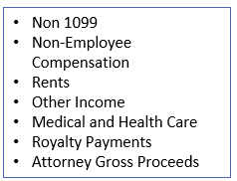
Verifying 1099 Data
Verify Vendors who should receive 1099s and their YTD amounts
Identify 1099 Vendors and non-1099 vendors
Review 1099 Type
Review Vendors’ qualifying YTD Taxable Total

Slide 14
Vendors Grid – 1099 Vendors
Use the Report Button to print and/or save your filtered grid settings.

Slide 15
Vendors’ Grid – Non-1099 Vendors
Use the MORE button: Tax ID Type, ID#, & Type 1099
Use Filters:
Active: =true
Type 1099 : = non 1099
YTD Taxable Total: >=600
Use the Type 1099 to filter on a specific 1099 type (i.e. Royalty Payments).
Use the YTD Taxable Total to filter on amounts
Use the Report button to print and/or save your filtered grid settings
Notes:
To double check vendors with $600 or more that maybe should be a 1099 vendor ( ? )

Slide 16
Vendors’ Grid – Non-1099 Vendors
Use the Report button to print and/or save your filtered grid settings
Notes:
To double check vendors with $600 or more that maybe should be a 1099 vendor ( ? )

Slide 17
Vendors’ Grid – Advance Query
Advanced Query can also be used to locate 1099 Vendors
Active = True
Type 1099 - Not equals - Non 1099
YTD Taxable Total >= 600
Appy Query
Save Query
to use again if you choose by Load Saved Query

Slide 18
Vendors’ Grid – Advance Query
Can be used to locate Vendors NOT marked to receive a 1099
Active = True
Type 1099 = non 1099
YTD taxable total >=600
Appy Query
Save Query
to use again if you choose by
Load Saved Query
Notes:
To double check vendors IN CASE they should be a 1099 vendor

Slide 19
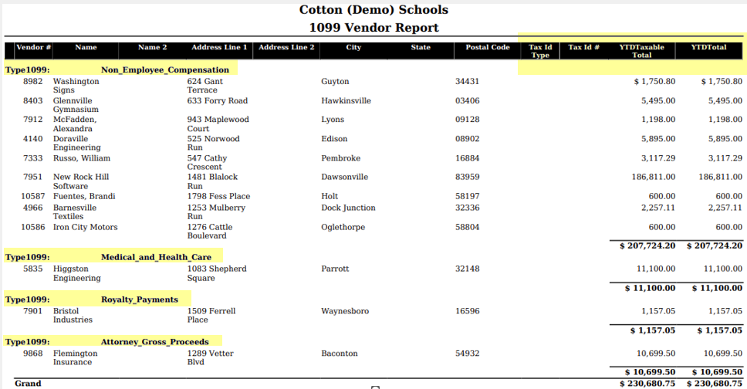
Can verify using 1099 Vendors Report

Slide 20
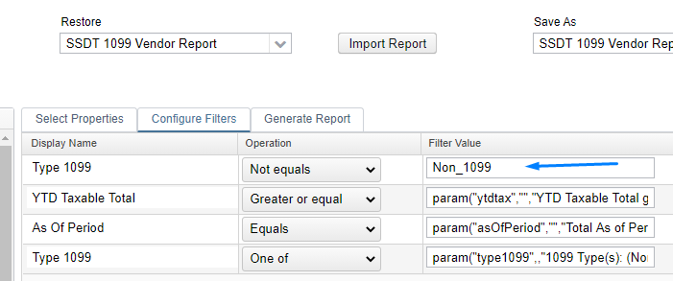
SSDT 1099 Vendor Report
Can Modify Configure Filters to run for specified 1099 Types

Slide 21
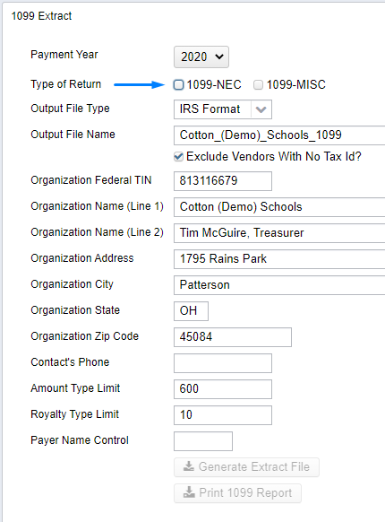
1099 Extracts Report *Menu options will look different depending on if ITC or District is creating/submitting Extract File
Periodic Menu > 1099 Extract > Print 1099 Report
Used to verify data prior to creating Extract File
Defaults to Exclude Vendors With No Tax Id
Must pick Type of Return before Print 1099 Report becomes available
Subtotals by 1099 Type
NOTE: This report can NOT be run until the
Posting Period for December has been created.

Slide 22
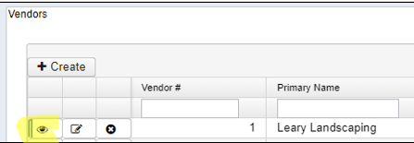
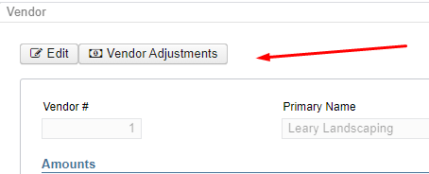
Vendor Adjustments
If a manual adjustment is needed on the Vendor’s YTD Amount
View the Vendor under Core
Click on Vendor Adjustments

Slide 23
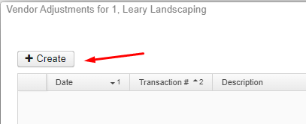
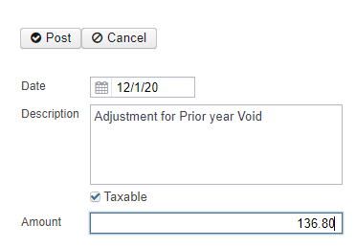
Vendor Adjustments
Create a new Adjustment
Enter Adjustment info
Amount can be positive or negative
Check Taxable box to update YTD Taxable Total
Notes:
Why may you need a Vendor Adjustment? 1-Prior Year Voided check 2-Royalties 3-Combining Vendors set up twice 4- Per the IRS, deceased employees wages on 1099

Slide 24
Month End Closing
Enter all transactions for the current month of December.
Attempt to reconcile USAS records with your bank(s)
Perform Bank Reconciliation Procedure (link is provided in the CYE checklist)
Under Periodic menu, select ‘Cash Reconciliation’ to enter your cash reconciliation information for the month
Generate the SSDT Cash Summary report and the SSDT Financial Detail report
The detail report may be run for the month in order to compare MTD totals to the Cash Summary report for December. Totals should match.
If totals agree . . . You are balanced & may proceed

Slide 25
Calendar Year End Closing
Printing of 1099 Forms – Will be done by NEOMIN for Calendar Year 2023
In USAS, Printer/Sealer copies are used to generate & print forms.
1099’s are run through an envelope sealer to seal the 1099 forms.
Submission of 1099 data to IRS – Will be done by NEOMIN for Calendar Year 2023
ITC: Transfer IRS Format 1099.TAP created in USAS
Close December by clicking on to close the December period.
Monthly Reports Archive will generate automatically when the posting period is closed.
Calendar Year End Reports Archive will generate.
Create new Posting Period for January under Core > Posting Periods

Slide 26
Monthly Report Bundle
REPORTS GENERATED when December 2023 posting period is closed:
Cash Reconciliation Report for the month
Monthly Balance Report
Cash-related Reports: Cash Summary Report / Financial Detail Report for the month / Financial Summary by Fund
Budget-related Reports:
Budget Summary / Budget Account Activity Report (for the month)
Budget Transactions Summarized by Appropriation / Appropriation Summary Report
Negative Budget Report / Negative Appropriation Account Report / Error Corrections & Supplies Distributions
Revenue-related Reports: Revenue Summary / Revenue Account Activity report for the month
PO-related Reports: Purchase Order Detail Report for the month / Outstanding Purchase Order Detail Report and /Transaction Ledger-Vendor Activity / Vendor Listing
Disbursement-related Reports: Disbursement Detail / Outstanding Disbursement Summary Report / Disbursement Detail
Receipt-related Reports:
Receipt Ledger Report for the month / Reduction of Expenditure Ledger Report for the month
Refund Ledger Report for the month / Void Refund Ledger Report
Transfer Advance Summary / Fund to Fund Transfer Ledger Report
User Listing AOS Extract

Slide 27
Additional Reports
Generate any optional reports that may not be included in the Monthly Report Bundle.
Spending Plan reports
Any reports the district normally generates monthly

Slide 28
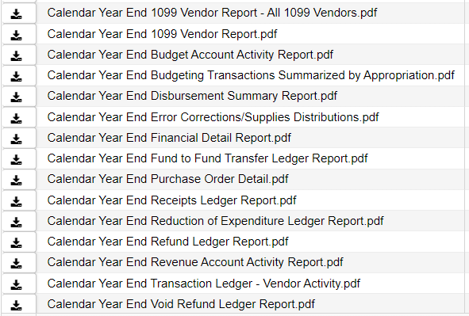
Calendar Year End Report Archive
Calendar Year End reports will be generated:

Slide 29
Calendar Year End Closing
Generate any additional Calendar Year End Reports
Custom reports
Proration Utility (i.e. for Workers Comp)
Proration Utility program generates a spreadsheet which may be used to assist in calculating prorated amounts for an expenditure.
For example, these prorated amounts can be based on salaries paid, and prorated to their mapped benefit account for Workers Comp, Insurance, etc.

Slide 30
Calendar Year Report Archive
Calendar Year Report Archive also stores:
1099 Extract Options generated by user:
IRS Submission Extract File (TAP)
Reference or Printer/Sealer (PDF) copies
1099 Report (pdf)

Slide 31
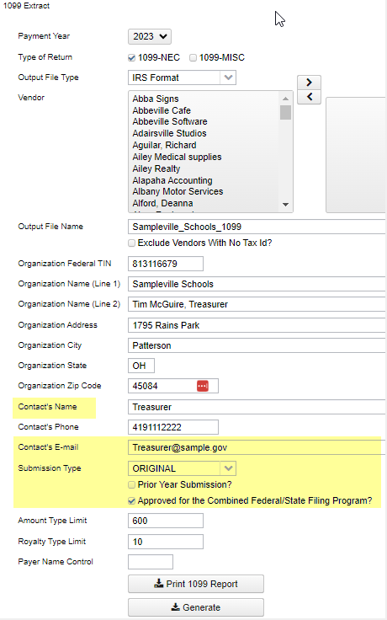
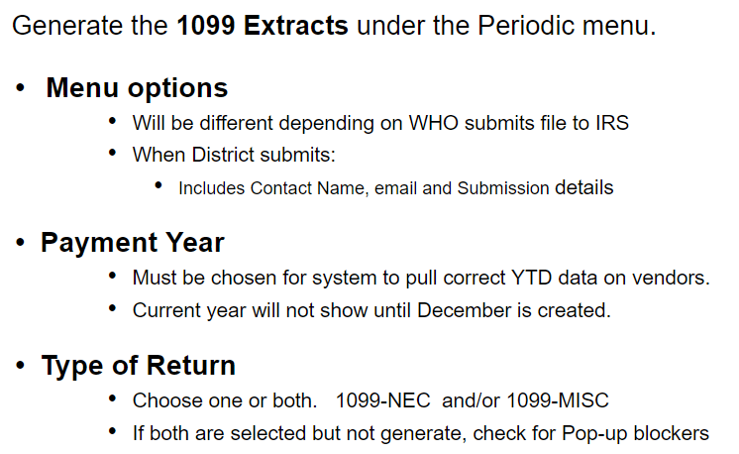
1099 Extracts
Once all 1099 data is verified, balanced and complete . . .
Notes:
Other screen options will be different depending on if ITC or District submits file to IRS

Slide 32
1099-NEC and 1099-MISC Forms
Generate Printed Forms:
Directly from the USAS Application.
Generate Submission File to IRS
NEOMIN
Note:
The submission and print files can be generated as part of the CYE Close process. They will be sent to the Calendar Year Reports Archive when the 1099 Extract is run.
If needed, they can be generated/regenerated after the close process.

Slide 33
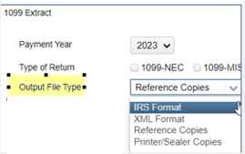
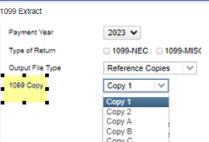
1099 Extracts
Periodic < 1099 Extracts
Output File Type
Output File Type:
IRS format (TAP) - Used for IRS electronic Submission
XML file – Often used with Third Party Software to print 1099s. No Longer Applicable
Reference Copies – Generates a PDF copy to save for your records.
When selected, dropdown of choices will appear for 1099 Copy:
Copy 1 - For State Tax Department
Copy 2 - Recipient's State Copy
Copy A - Internal Revenue Service Center copy
Copy B - For Recipient
Copy C - For Payer
Printer/Sealer Copies
Used for direct printing and formatted to fit 8 ½ x 11 Z-Fold Forms only.
Contains both Copy 2 and Copy B that will be provided to 1099 vendors (recipient)
Notes:
Other screen options will be different depending on if ITC or District submits file to IRS

Slide 34
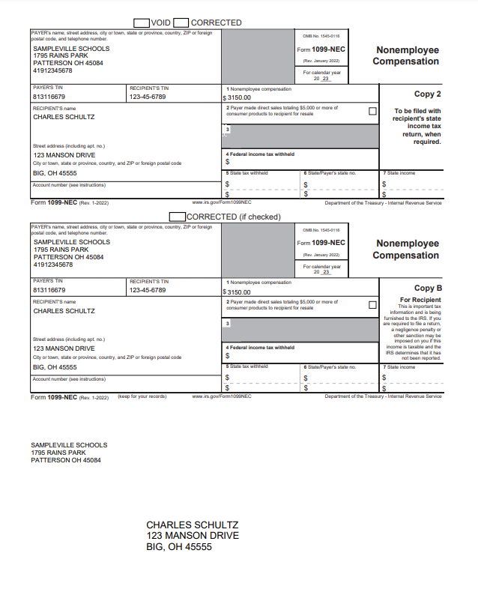
1099 Printed Forms
Print 1099 Forms from USAS: (Periodic < 1099 Extracts)
Output File Type: Printer/Sealer forms (PDF)
Formatted to fit 8 ½ x 11 Z-Fold forms only
Copy 2 - Recipient's State Copy
Copy B - For Recipient
Separate output file types for each form type:
1099-NEC and 1099-MISC

Slide 35
1099 Reference Copies
Print 1099 Forms from USAS: (Periodic < 1099 Extracts)
Generate Reference Copies if desired to keep for ITC/District records
Copy 1 - For State Tax Department
Copy 2 - Recipient's State Copy
Copy A - Internal Revenue Service Center copy
Copy B - For Recipient
Copy C - For Payer
All Reference copies can be scheduled to run at once using the Job Scheduler
class org.ssdt_ohio.usas.reporting.form1099.All1099CopiesJob

Slide 36
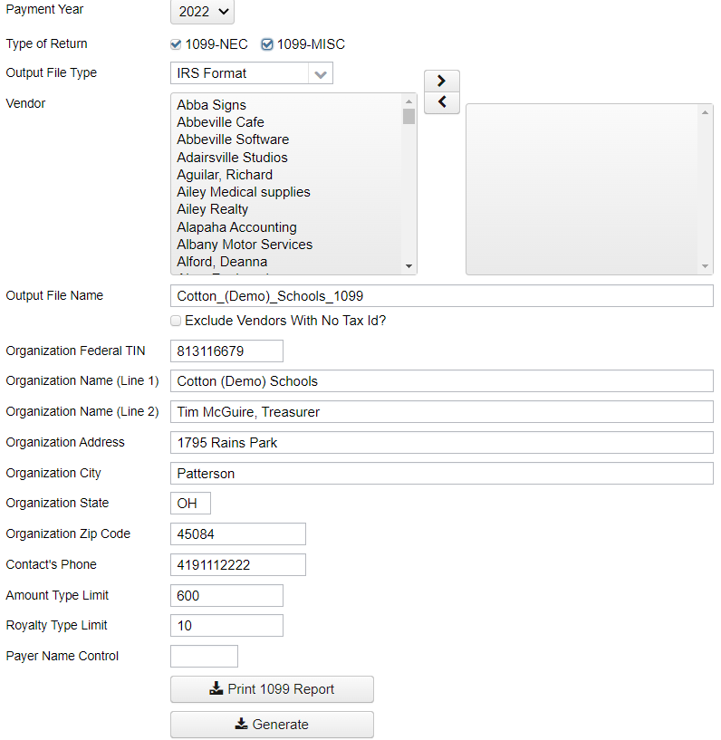
1099 File submitted to IRS …. by ITC
Payment Year: choose with drop down.
(December Posting Period must be created to show current year)
Type of Return: Check mark one or both
Output File Type:
IRS Format (TAP) - for IRS submission
Organization Will populate from Organization information
Print 1099 Report – Click to generate the 1099 pdf report(s)
Generate - Click to generate the selected output file type

Slide 37
1099 File submitted to IRS …. by ITC
Download from District’s Calendar Year Reports Archive or generate.
The file names will reflect the district name and whether they are for just 1099-NEC, 1099-MISC or both. i.e. Cotton_(Demo)_Schools_1099_BOTH.tap

Slide 38
Questions ?

Slide 39
NEOMIN Holiday Hours ~ 2023
December 25, 2023 – Closed
December 26, 2023 – Closed
December 27, 2023 – 8:00 am – 4:00 pm
December 28, 2023 – 8:00 am – 4:00 pm
December 29, 2023 – Closed
January 01, 2024 – Closed
January 02, 2024 – 8:00 am – 4:00 pm

